Slide 1

CIFAR-100 Image Classification
Tai Ngo
DSC-680
Bellevue University

Slide 2
Objectives
Use Deep Learning to perform image classification by using a Convolutional Neural Networks (CNN) model
Test different parameters inside the CNN model to determine the parameters that produce the highest accuracy score
The result of this project can aid deep learning researchers or enthusiasts in building their first model for image classification.

Slide 3
Related Fields
Artificial Intelligence (AI)
Machine Learning (ML)
Deep Learning (DL)
Image Classification with Convolutional Neural Network (CNN)

Slide 4
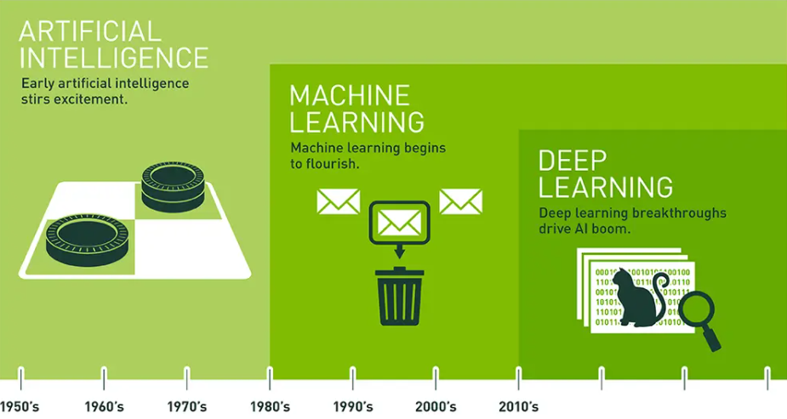
Related Fields
(Image Source: https://blogs.nvidia.com/blog/2016/07/29/whats-difference-artificial-intelligence-machine-learning-deep-learning-ai/)

Slide 5
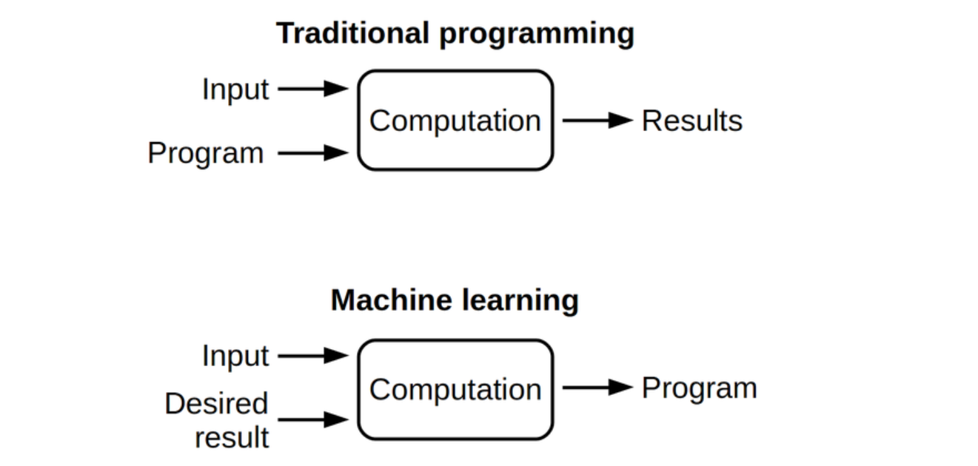
Machine Learning
ML creates a new approach to
the way we work with computer.
This new approach creates new
purposes and expectations from
our computational power.
(Image source: https://futurice.com/blog/differences-between-machine-learning-and-software-engineering)

Slide 6
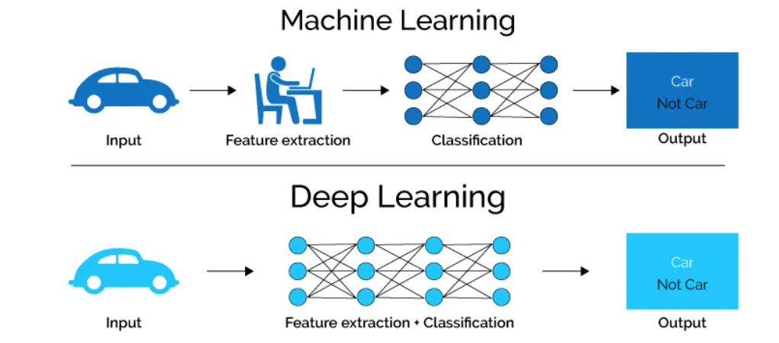
Deep Learning vs. Machine Learning
(Image Source: https://semiengineering.com/deep-learning-spreads)

Slide 7
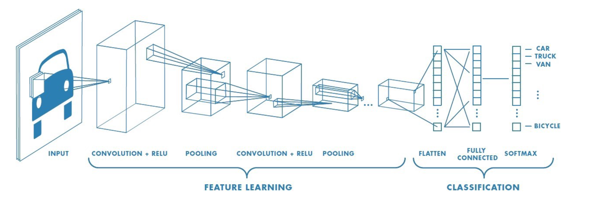
Convolutional Neural Networks (CNN)
(Image Source: https://towardsdatascience.com/a-comprehensive-guide-to-convolutional-neural-networks-the-eli5-way-3bd2b1164a53)

Slide 8
Convolutional Neural Networks (CNN)
Image to Convolved Feature
Pooling Layer
Classification with Fully Connected Layer

Slide 9
CIFAR-100 Dataset
60,000 32x32 color images
10 class – 6,000 images per class
50,000 training images and 10,000 test images
Download link https://www.cs.toronto.edu/~kriz/cifar.html

Slide 10
Experiments
Number of Conv2D Layers and their hidden units
Number of MaxPooling2D Layers
Number of Dense Layers’ hidden units
The activation function
The optimizer
The loss function
The metrics for accuracy

Slide 11
Experiments
First Experiment: Compare number of layers (2 Conv2D vs 3 Conv2D)
Second Experiment: Compare the hidden units (128 vs 256)
Third Experiment: Compare the optimizer (rmsprop vs adam)

Slide 12
First Experiment
Comparing two cases (Conv2D with 128 hidden units):
2 Conv2D Layers
1 MaxPooling2D Layer
And:
3 Conv2D Layers
2 MaxPooling2D Layers
Study about different numbers of layers

Slide 13
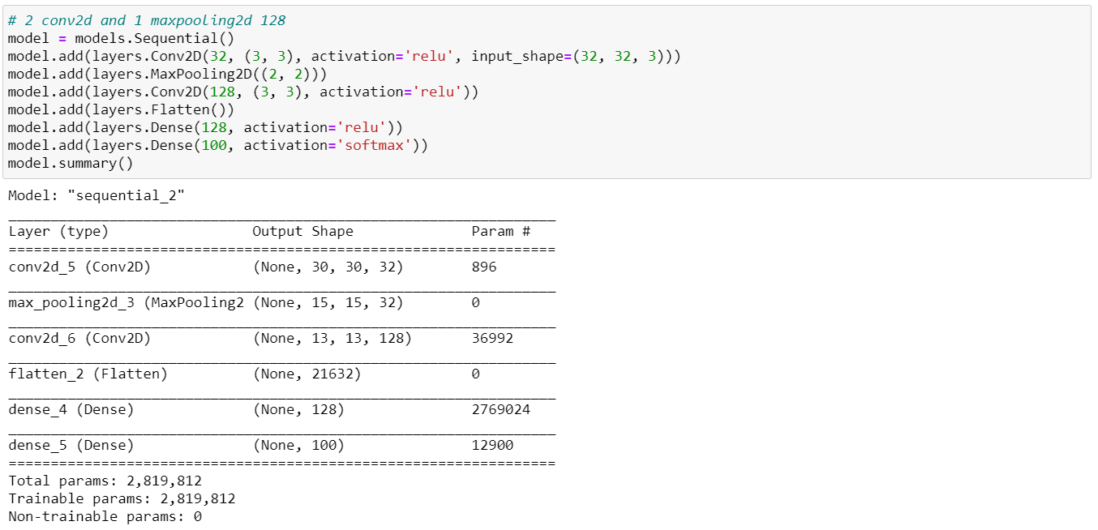
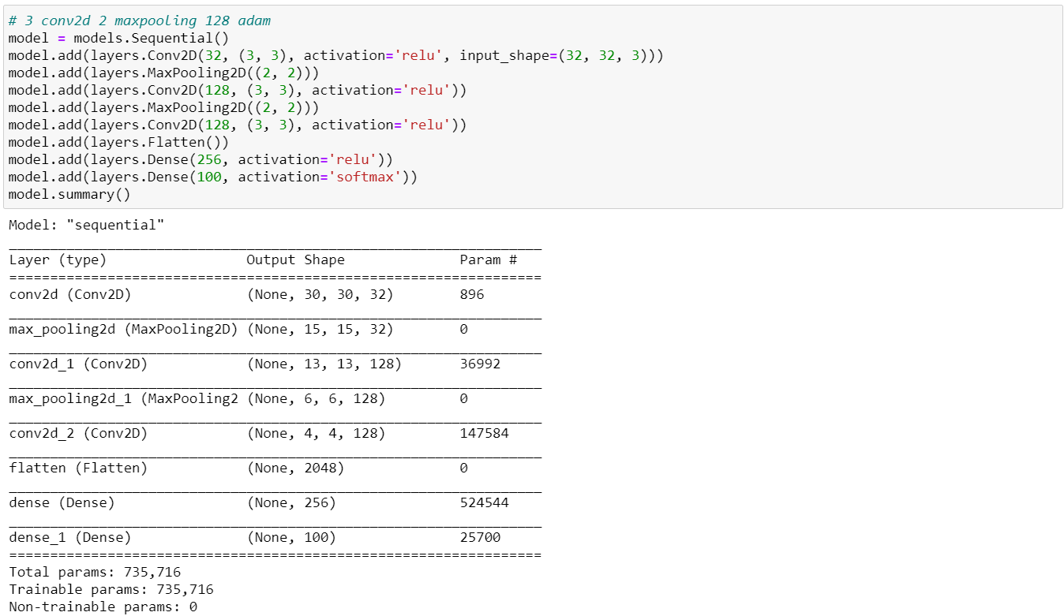
First Experiment

Slide 14
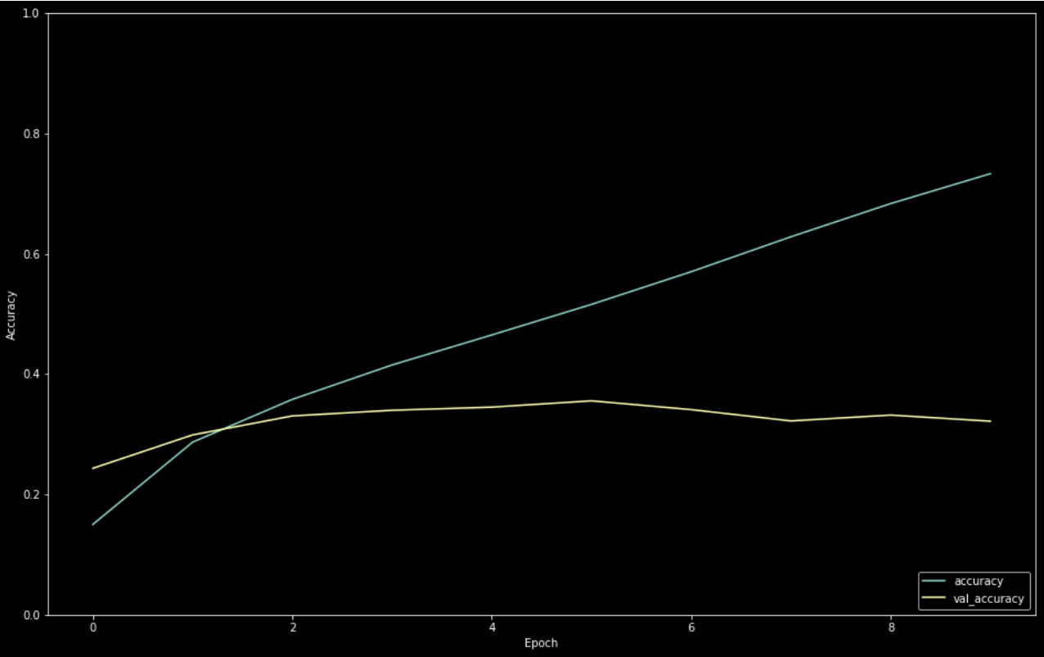
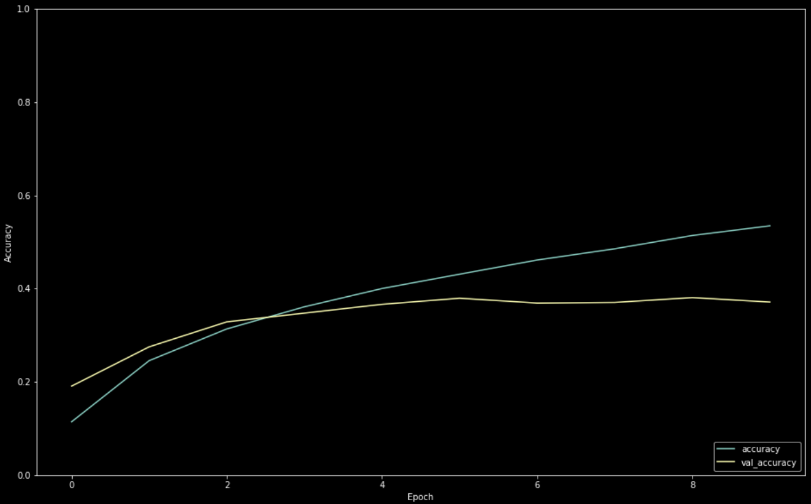
First Experiment
2 Conv2D – peak accuracy: 0.3556
3 Conv2D – peak accuracy: 0.3808

Slide 15
Second Experiment
Comparing two cases:
3 Conv2D Layers – 128 hidden units
2 MaxPooling2D Layer
And:
3 Conv2D Layers – 256 hidden units
2 MaxPooling2D Layers
Study about different numbers of hidden units

Slide 16

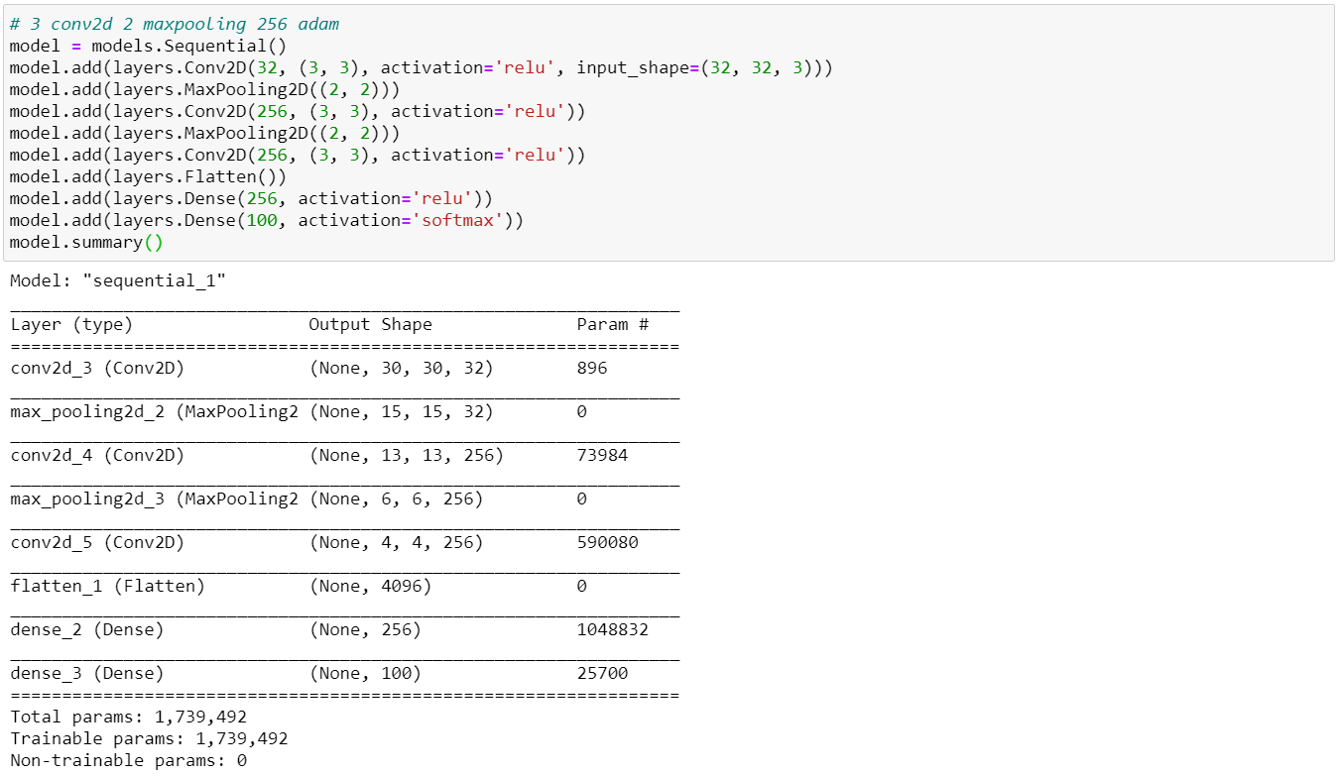
Second Experiment

Slide 17
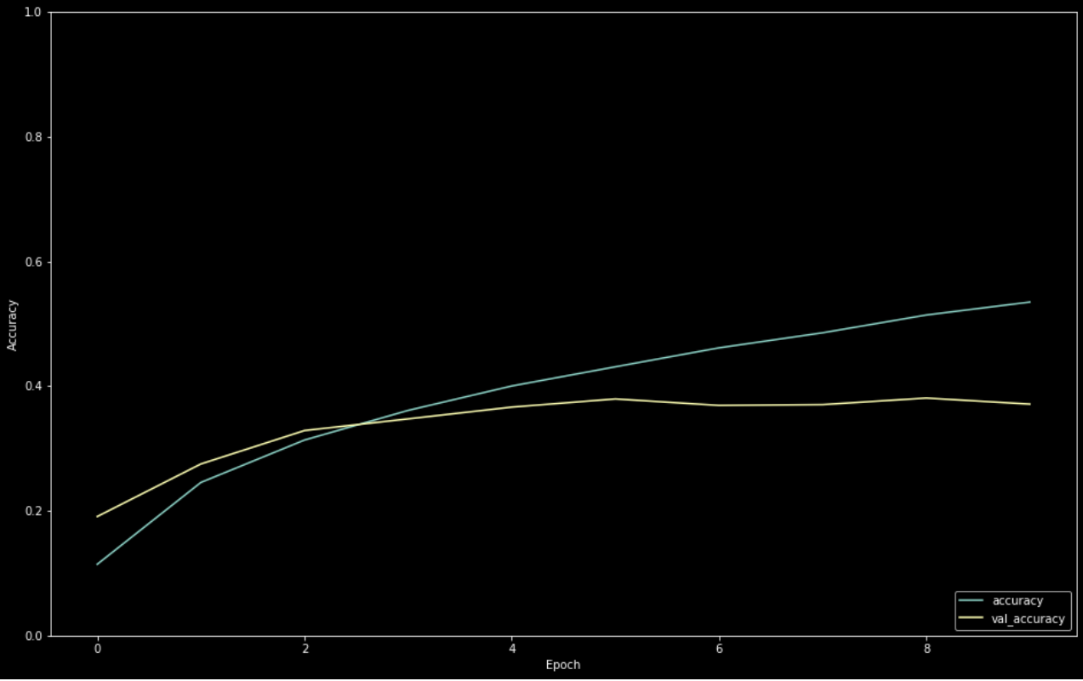
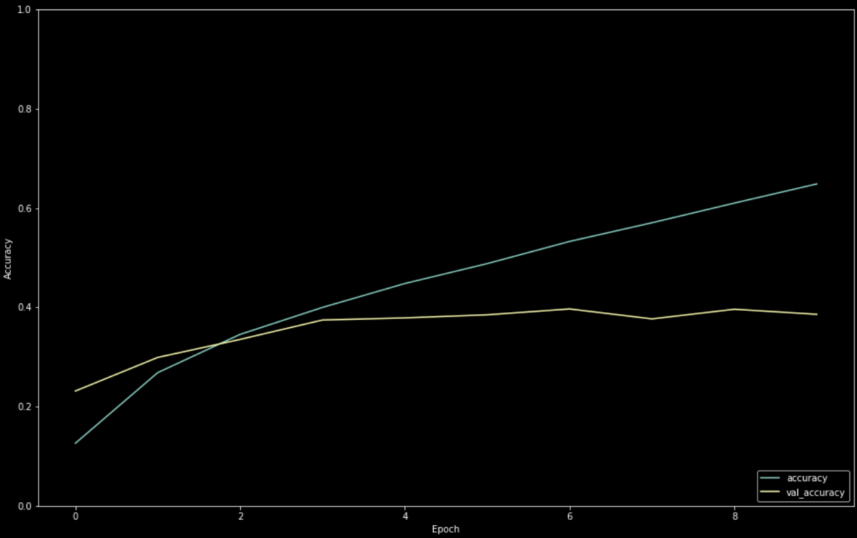
Second Experiment
128 hidden units – peak accuracy: 0.3808
256 hidden units – peak accuracy: 0.3967

Slide 18
Third Experiment
Comparing two cases:
“adam” optimizer
And:
“rmsprop” optimizer
Study about different optimizers

Slide 19


Third Experiment

Slide 20
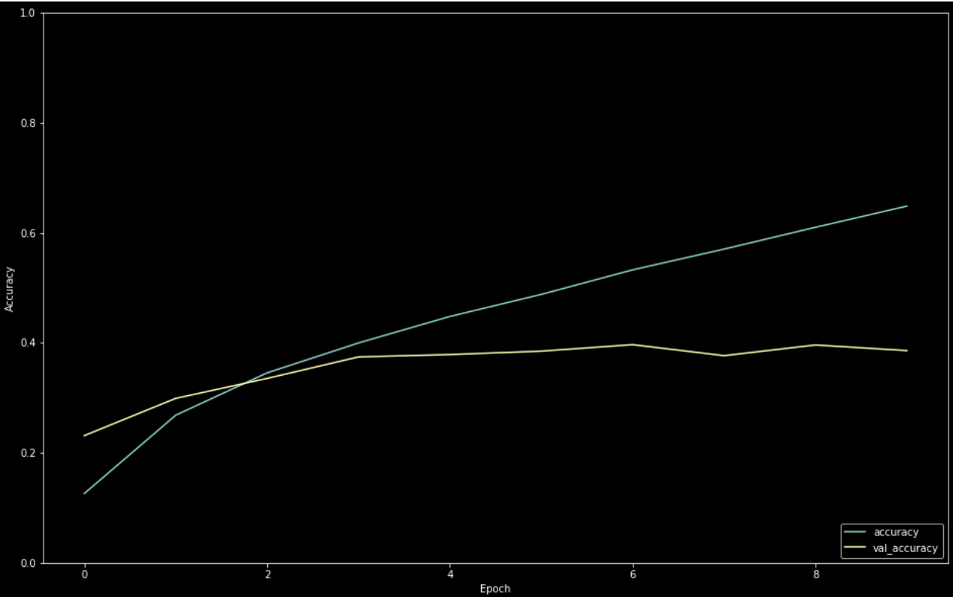
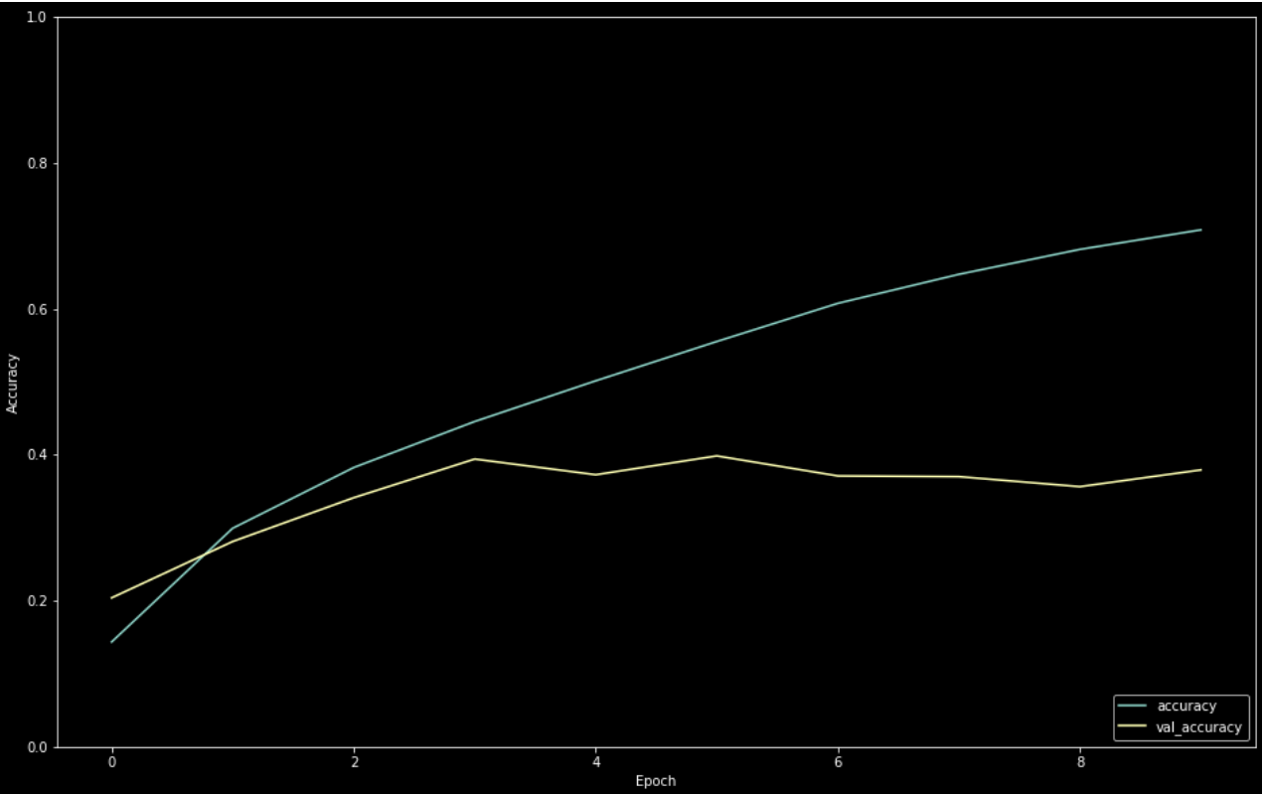
Third Experiment
“adam” – peak accuracy: 0.3967
“rmsprop” – peak accuracy: 0.3985

Slide 21
Summary
Alternating the number of layers, hidden units and the optimizers gives different accuracy scores.
The parameters that provide the highest accuracy score are 3 Conv2D, 2 MaxPooling2D, and “rmsprop” for the optimizer.
Other notes:
Tried higher number of layers and hidden units, but the overfitting was worse
Recommendation: adding a dropout or a regularization might be a good experiment.

Slide 22
Q & A
How does this project contribute to business needs?
The accuracy score is low since it is only 0.3985. Is it sufficient to be used to build a new network from scratch?
If somebody does not want to use these parameters, what is the alternative to perform image classification?
What other experiments can be done to improve the model?

Slide 23
References
https://blogs.nvidia.com/blog/2016/07/29/whats-difference-artificial-intelligence-machine-learning-deep-learning-ai/
https://semiengineering.com/deep-learning-spreads/
https://futurice.com/blog/differences-between-machine-learning-and-software-engineering
https://towardsdatascience.com/a-comprehensive-guide-to-convolutional-neural-networks-the-eli5-way-3bd2b1164a53

